Slide 1
Software Analysis and Design
Role of System Analyst
Department of Software Engineering,
FAST-NUCES, CFD Campus

Slide 2
Lecture Objectives
What and how domain
Vision Fundamentals
System Analyst Fundamentals
System Analyst Roles

Slide 3
Lecture Material
System analysis and design in a changing world (Online chapterA)

Slide 4
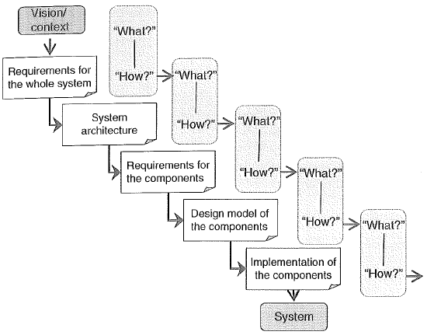
Problem vs Solution

Slide 5
Vision
The Vision is an outcome of the company’s business and portfolio of investment strategy.
Vision states the goal not the way to achieve it.
System Vision Document
  Problem Description
    What is the problem and idea for the solution?
  System Capabilities
    What are the capabilities the new system will have?
    Helps define the scope
  Business Benefits
    The benefits that accrue to the organization
    Tangible (in dollars) and intangible benefits

Slide 6
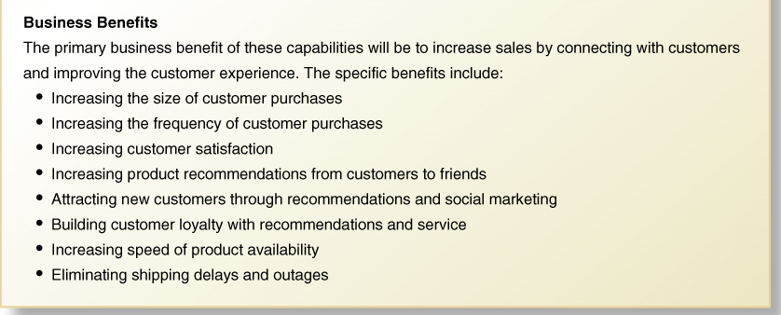
Vision

Slide 7
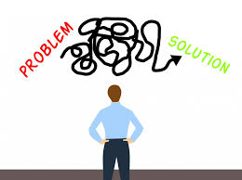
Vision
Identify a problem
  Respond to an opportunity
    Strategic initiative
    Something that provides competitive advantage
  Resolve a problem
    Operational issues keep coming up
    User needs aren’t being met
  Meeting User Needs
  Respond to an external directive
    Legislation requires new form of reporting
    Changes in tax laws or regulations

Slide 8
Examples
Responding to an Opportunity:
  Example: A technology company identifies a growing trend in remote work and realizes there is an opportunity to develop and market collaboration software tailored specifically for remote teams.
  By investing in this area and providing a solution that meets the unique needs of remote workers, the company gains a competitive advantage in the market.
Resolve a problem:
  Example: A retail chain consistently receives complaints from customers about long checkout lines during peak hours.
  After analyzing the issue, the company implements self-checkout kiosks in its stores to alleviate congestion and improve the shopping experience for customers.

Slide 9
Examples
Meeting User Needs:
  Example: A mobile app development company notices that users are frustrated with the complexity of existing fitness tracking apps.
  In response, they design a simple, intuitive fitness app that focuses on key features users want most, such as tracking daily steps and calorie intake. By meeting the specific needs of users in a user-friendly manner, the company gains a loyal user base and a competitive edge in the crowded app market.
Responding to an External Directive:
  Example: A financial services firm is required by new government regulations to implement stricter security measures to protect client data. In response to these directives, the company invests in upgrading its cybersecurity infrastructure and implements additional protocols to ensure compliance with the regulations. By proactively responding to external directives, the company avoids legal penalties and maintains the trust of its clients.

Slide 10
Vision
The Vision answers some of the big questions:
  Why are we building this product, system, or application?
  What problem will it solve?
  What features and benefits will it provide?
  For whom does it provide these features and benefits?
  What performance, reliability, and scalability must it deliver?
  What platforms, standards, applications, and so on, will it support?

Slide 11
Vision
Vision is a clear goal that defines what a system aims to achieve, without detailing how to accomplish it. It aligns with the company’s business objectives and investment strategy, guiding system development toward solving a specific problem and delivering value to stakeholders.
Example:
"To create an AI-powered healthcare assistant that improves patient diagnosis and reduces hospital wait times."

Slide 12
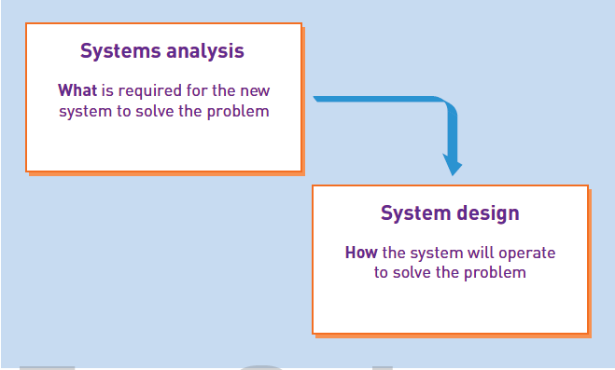
System Analysis and Design
Systems Analysis – those activities that enable a person to understand and specify what an information system should accomplish.
Systems Design – those activities that enable a person to define and describe in detail the system that solves the need

Slide 13
System Analysis and Design
systems analysis and design provides the tools and techniques you need as an information system developer to complete the development process:
Understand the need (business need).
Capture the vision.
Define a solution.
Communicate the vision and the solution.
Build the solution or direct others in building the solution.
Confirm that the solution meets the need.
Launch the solution application.

Slide 14
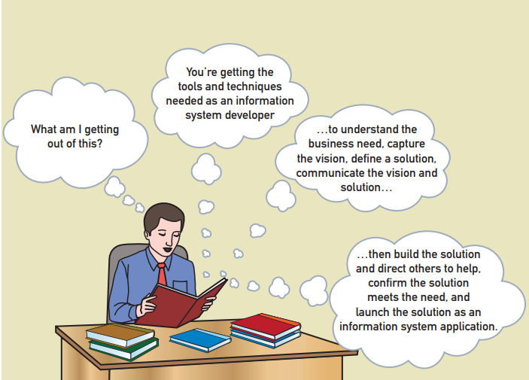
System Analysis and Design

Slide 15
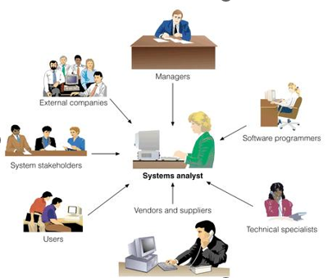
System Analyst
Investigates, analyses, designs, develops, installs, evaluates, and maintains a company’s information systems
  Constantly interacts with users and managers within and outside the organisation

Slide 16
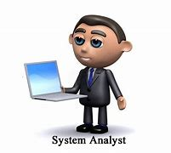
System Analyst
System analyst
  Acts a translators to managers and programmers
  Best line of defense in an IT disaster
  Most valuable skill: ability to listen
  Seeks feedback from users to ensure that systems do not go off track

Slide 17
System Analyst
Knowledge, skills, and education
  Technical knowledge
  Communication and business skills
  People knowledge and skills
  Critical thinking skills
  Education: college degree in information systems, science, or business
    Some IT experience is required
  Integrity and ethics

Slide 18
System Analyst
Research and understand the problem.
Verify that the benefits of solving the problem outweigh the costs.
Define the requirements for solving the problem.
Develop a set of possible solutions (alternatives).
Decide which solution is the best and make a recommendation.
Define the details of the chosen solution.
Implement the solution.
Monitor to make sure the desired results are obtained.

